Slide 1


Team 61: Project Name
Bi-Weekly Update 2 William Jachimiak, Jean Jacques Chirat,
Preston Bowyer, Aiden George
Sponsor: Professor Arya Menon
TA: Manoj Kumar Balamurugan
Notes:
Michelle

Slide 2

Project Summary
Our project seeks to solve the problem of monitoring fall injury prone individuals in assisted-care through the following implementation:
Collection of vertical position & velocity data (minimally invasive) using mmWave radar
Stream the data to Raspberry Pi to be processed by ML detection algorithm
Pi communicates positive detection result over WiFi network to Firebase cloud
Firebase interfaces with Android app to notify assisted-care workers if fall event occurs
Notes:
Kyle

Slide 3
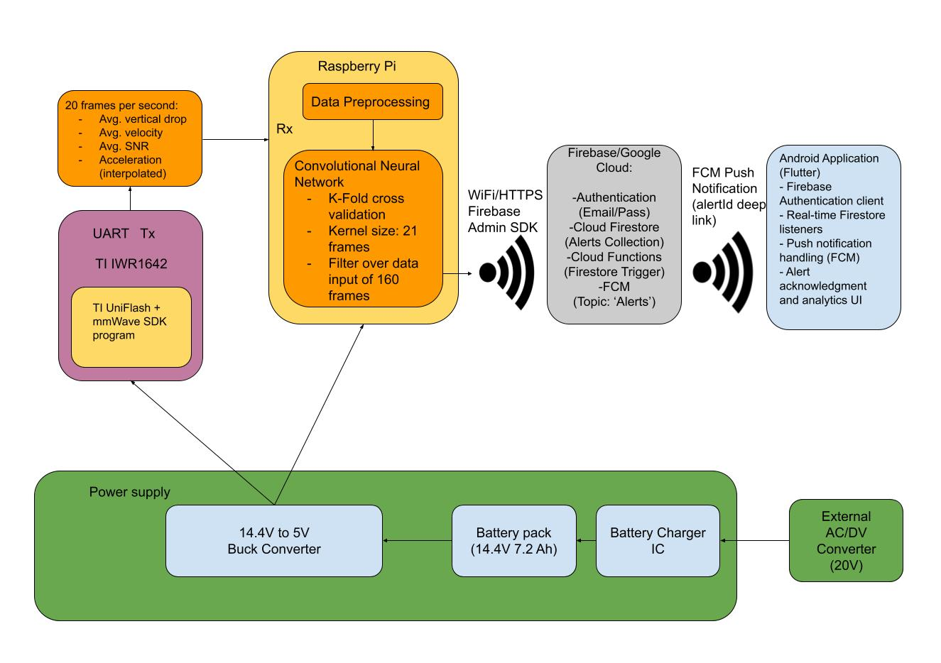
Project/Subsystem Overview
Notes:
Eric

Slide 4
Project Timeline
Subsystem Designs and Testing (completed 02/05) | Integration of SBC and ML (to complete by 02/20) | Integration of SBC and App (to complete by 02/20) | Final Integration (to complete by 03/05) | System Test (to complete by 03/26) | Validation (to complete by 04/02) | Demo and Report (to complete by 04/21)
Notes:
Eric

Slide 5
MCU/SBC
William Jachimiak
Accomplishments since last update 15 hrs of effort | Ongoing progress/problems and plans until the next presentation
Sent alert over WiFi to the Firebase cloud and created a class to run continuously Ongoing integration with ML | Verifying data transfer to the machine learning class Testing fall detection using real time data

Slide 6
MCU/SBC
William Jachimiak

Slide 7
Machine Learning Subsystem
Jean Jacques Chirat
Accomplishments since last update 8 hrs of effort | Ongoing progress/problems and plans until the next presentation
Adapted existing code onto MCU for ML dataflow Implemented new class & function on MCU to do inferencing on real-time data | Verify that data is 1:1 with model input format Verify that MCU is able to compute prediction result within specified time limit Validate entire data pipeline from radar to ML output (while actually operating)

Slide 8
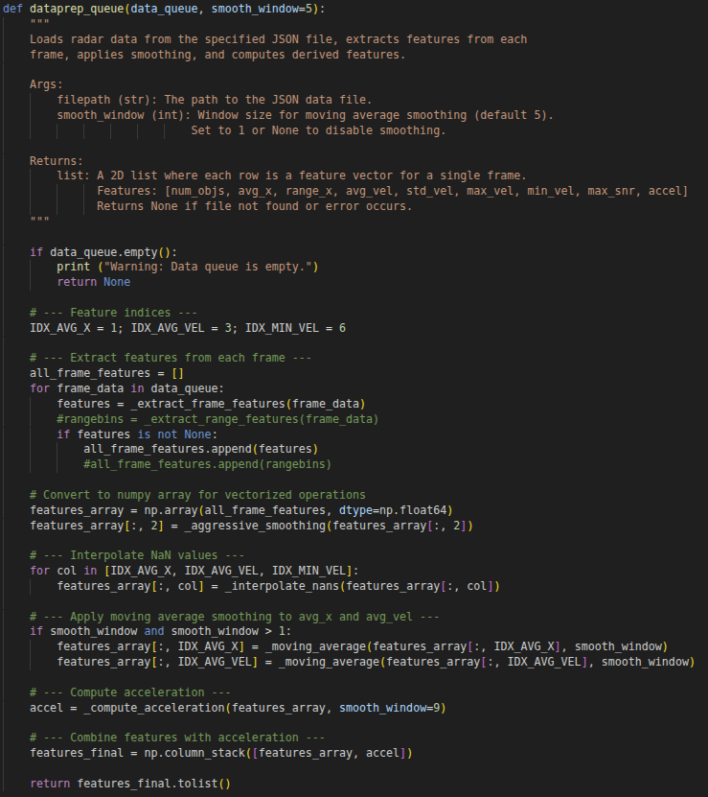
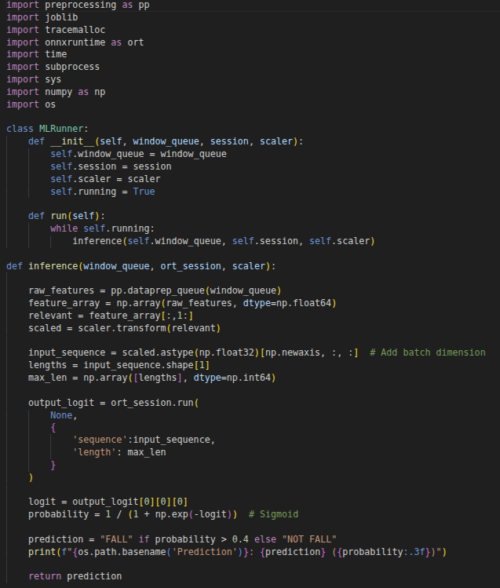
Machine Learning Subsystem
Jean Jacques Chirat
Preprocessing code adapted for MCU
New code for

Slide 9
Power Supply
Aiden George
Accomplishments since last update 25 hrs of effort | Ongoing progress/problems and plans until the next presentation
Finished redesign and integration of battery charger IC Ordered for parts and board Created CAD design for system enclosure and mounting bracket design for parts | Complete soldering of board and begin validation of design Finish MCU and Radar Bracket Mounts 3D print initial model and ensure fitting of parts

Slide 10
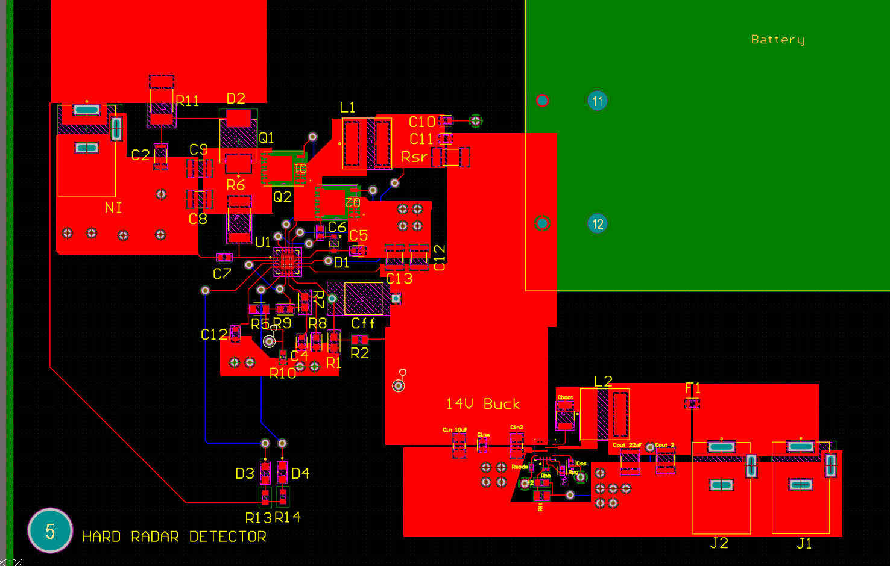
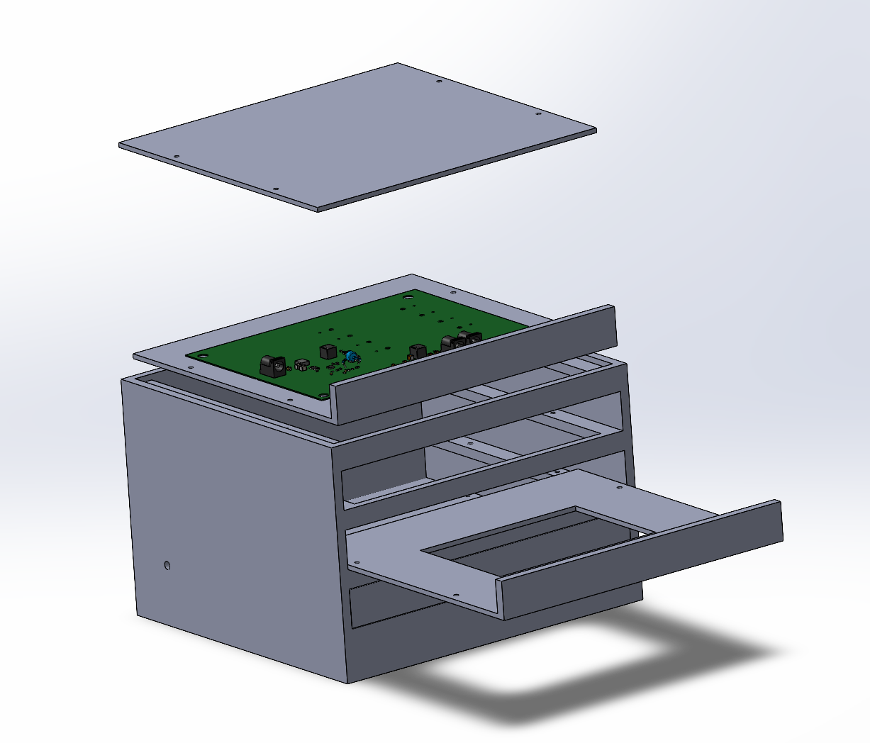
Power Supply
Aiden George

Slide 11
End User App
Preston Bowyer
Accomplishments since last update 13 hrs of effort | Ongoing progress/problems and plans until the next presentation
Implemented the pipeline for the Raspberry Pi to publish detection and alert data to the cloud backend. Validated that alert data generated on the Pi is reliably written to the database. | Integrating Firestore publishing into the Raspberry Pi’s main detection runtime Refactoring the current standalone publishing script into a reusable module Automating execution on startup to remove manual intervention

Slide 12
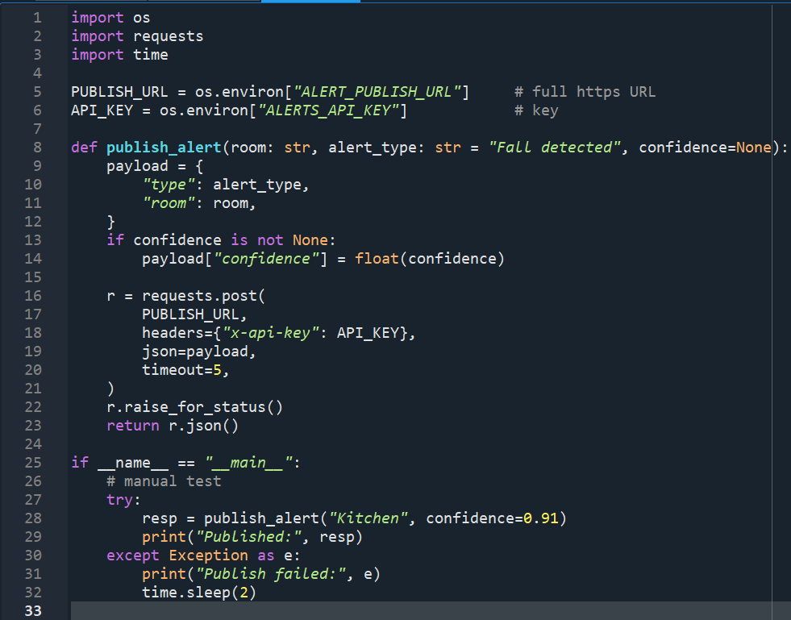
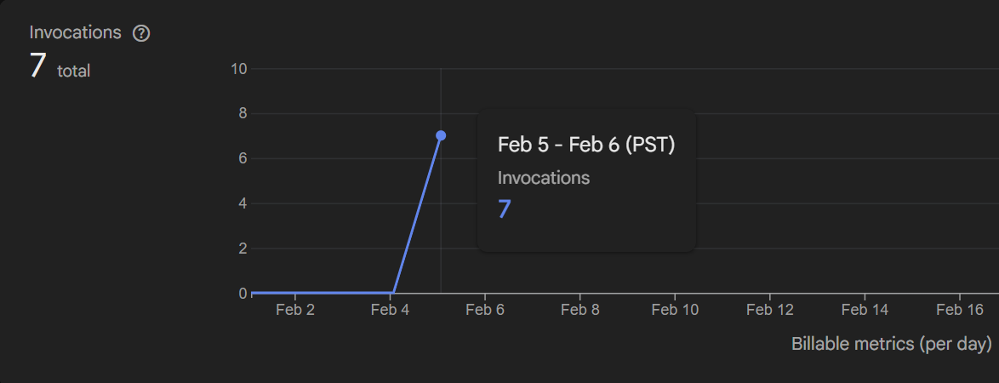
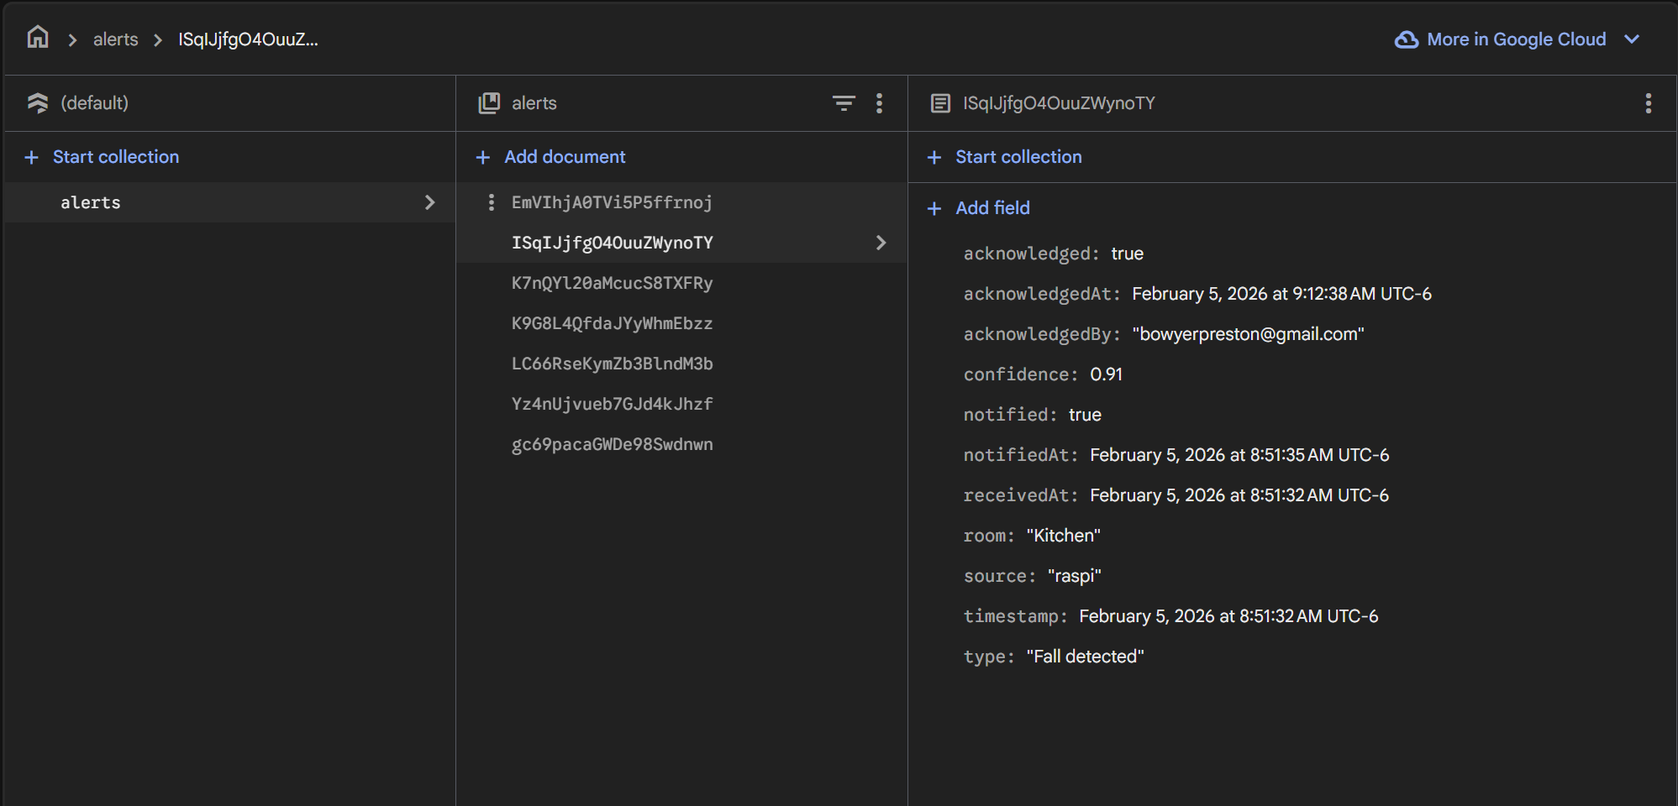
End User App
Preston Bowyer

Slide 13
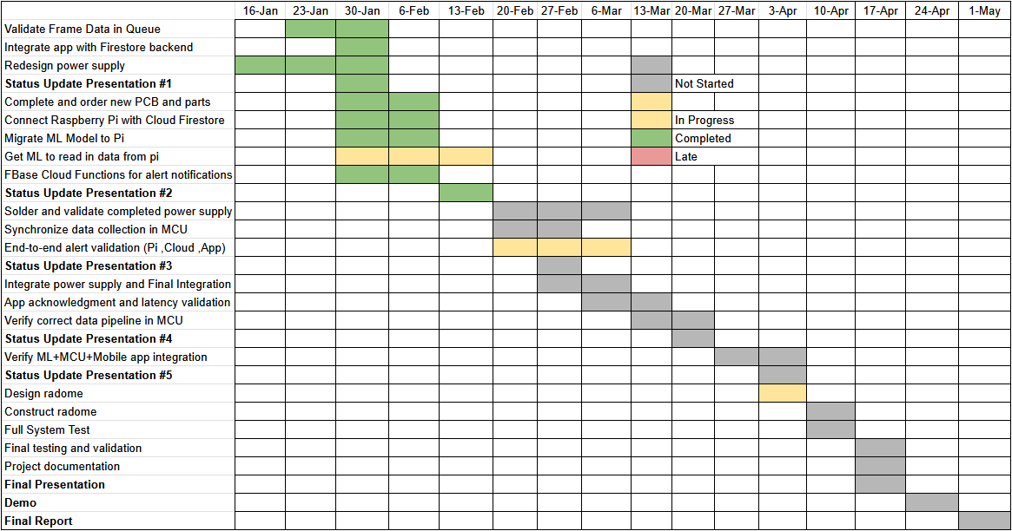
Execution Plan
Notes:
Michelle

Slide 14
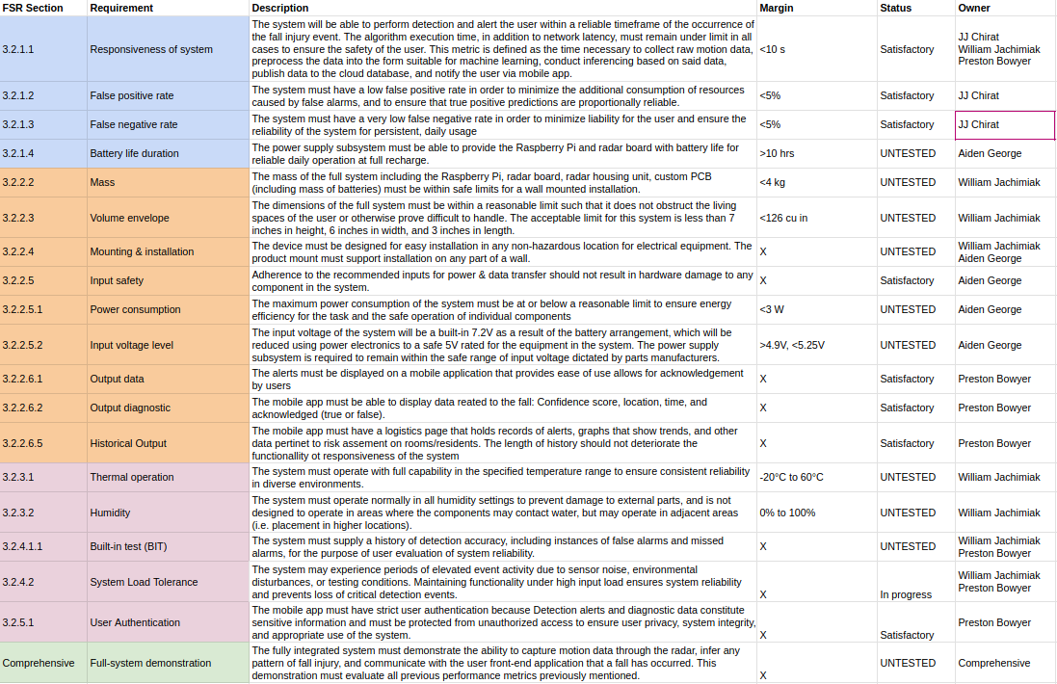
Validation Plan
Notes:
Michelle

Slide 15
Thank you for listening!
Q&A

